Slide 1
Restaurant Management System
01

Slide 2
Group Members
Kowser Ahmed Sajol
MD.Belal Hossen
183002049
183002127
02

Slide 3
CONTENTS
Introduction
Purpose
Existing Features
Main Menu
Sub Menu
Amount Calculation
Require Application
Advantages
Conclusion
03

Slide 4
INTRODUCTION
A customer can order any types of foods as he/she likes. In this project we’ve made a program for those restaurants whom need to manage there regular activities like ordering foods and managing there total amount.
04

Slide 5
Purpose
This system reduces the time consumption
This project helps the management system to know customers order details in few seconds
Easy to Buy and select products
05

Slide 6
Existing Features
Main Menu
Sub-Menu
Amount Calculation
06

Slide 7
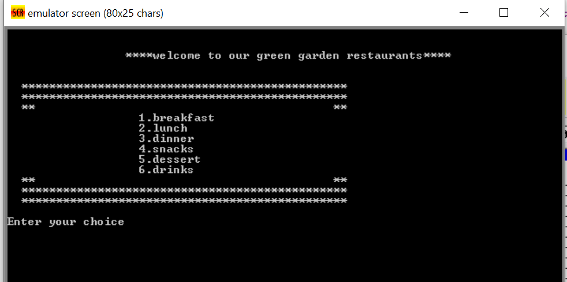
Main Menu :
07

Slide 8
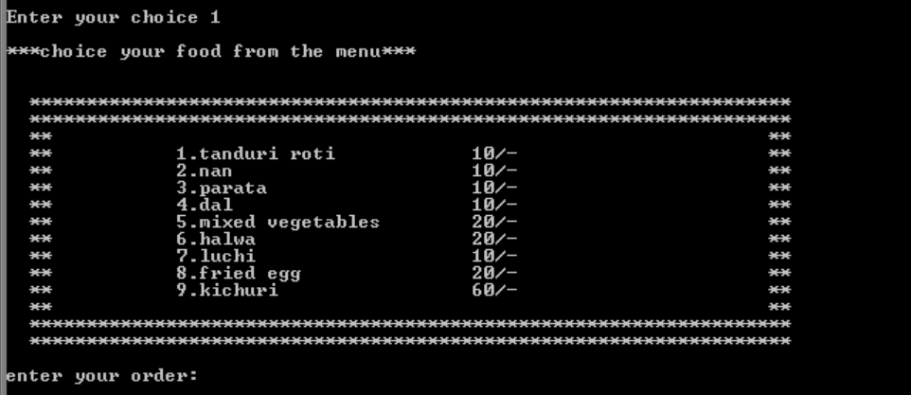
Sub Menu :
08

Slide 9
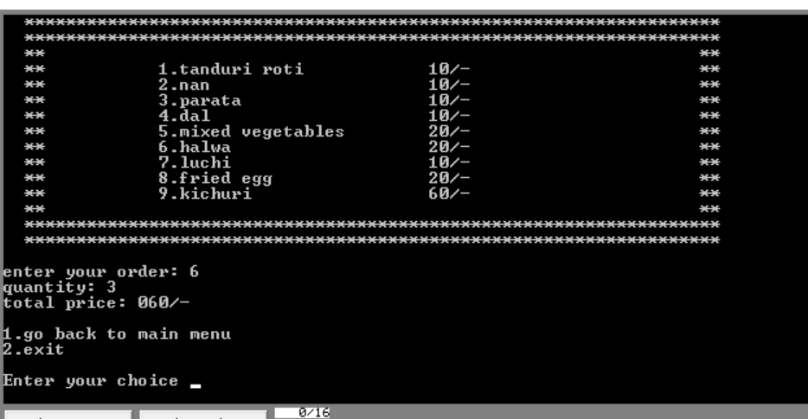
Amount Calculation:
09

Slide 10

Require Application :
10

Slide 11
Advantages of Restaurant Management System
Improve Customer Relationships.
Automatic Analysis.
Employee Satisfaction.
Reduction of Errors.
Enhanced Productivity.
Effective Use of Human Resources.
11

Slide 12
Conclusion
The purpose of our project is to ordering foods, We have able to complete our target. We have learned a lot from this project and have worked with great pleasure.
12

Slide 13
Thank You
13

